Slide 1
An Introduction to Beluga
Sean Matthew Nolan

Slide 2
Overview
Introduction
Indirect vs. Direct Optimization
Solver Description
Algorithmic Overview
Indirect Optimization
Continuation Methods
BVP Solving
Examples
Brachistochrone Problem with Input Details
Planar Hypersonic Problem
3DOF Hypersonic Problem
Estimation Problems
Conclusion

Slide 3
Introduction
Beluga is a optimization framework for optimal control problems (OCP)
Python 3.5+
Available with MIT License from
https://github.com/Rapid-Design-of-Systems-Laboratory/beluga
PyPI with pip install beluga
Documentation: https://beluga.readthedocs.io/en/latest/
Practically only publicly available solver capable of solving problems using indirect methods
Abstracts and automates optimization process for user

Slide 4
Optimization Techniques
Direct Methods
Discretize a problem's state and control variables and then adjusts them directly to minimize the objective function
Advantages:
Simpler for user to pose problem
Many solvers available
Indirect Methods
Apply optimal control theory to find the optimally conditions in terms of adjoint differential equations (costates), minimum principle, and boundary conditions
Advantages:
Result in high quality solutions
Computational benefits: parallelizable, mitigated curse of dimensionality, fewer numerical artifacts, dynamics always enforced

Slide 5
Software Available for Optimal Control
Name | Method
GPOPS (I and II) | Direct
DIDO | Direct
OTIS | Direct
POST (I and II) | Direct
PSOPT | Direct
PROPT | Direct
Name | Method
DIRCOL | Direct
Various STK propagators | Direct
OptimTraj | Direct
opty | Direct
OpenGoddard | Direct
dynopt | Direct
Name | Method
FROST | Direct
GESOP/Astos | Direct
SOCS | Direct
HamPath* | Indirect
OCCAL** | Indirect
beluga*** | Indirect
* HamPath does not perform dualization. The user is required to do it manually
** Other than a single 1994 publication, OCCAL is nonexistent
*** The solver of explained here

Slide 6
Beluga Details

Slide 7
Beluga Flowchart
Input OCP
Form BVP: Boundary value problem is formed with optimal control theory (indirect) or arranged as parameter optimization problem (direct)
Continuation: Solver solves problem with difficult-to-solve BC values, constants, constraints, etc. by “stepping” toward it using easier-to-solve problems as guesses for more difficult ones
Solve BVP: The BVP for that continuation step is solved using a shooting or collocation method
Form BVP
Form Initial Guess
Continuation Handling
No
Final BVP?
Yes
Solve Latest BVP
Solutions

Slide 8
Expanded Beluga Flowchart with Shooting Method
Start
Set BCs for Next Continuation Step
OCT and
Initialization
Form Necessary Conditions using OCT
Set Guess for Initial States from Previous Solution
Continuation Handling
Initialize Continuation Process
Solve TPBVP using Shooting Method/Newton Method Root Solving
Propagate Trajectory and STM Forward
Form Initial Guess
Check BCs Residuals
Yes
Scale Problem
Converged?
Cont. Done?
No
No
Apply Corrections using STM
Yes
End

Slide 9
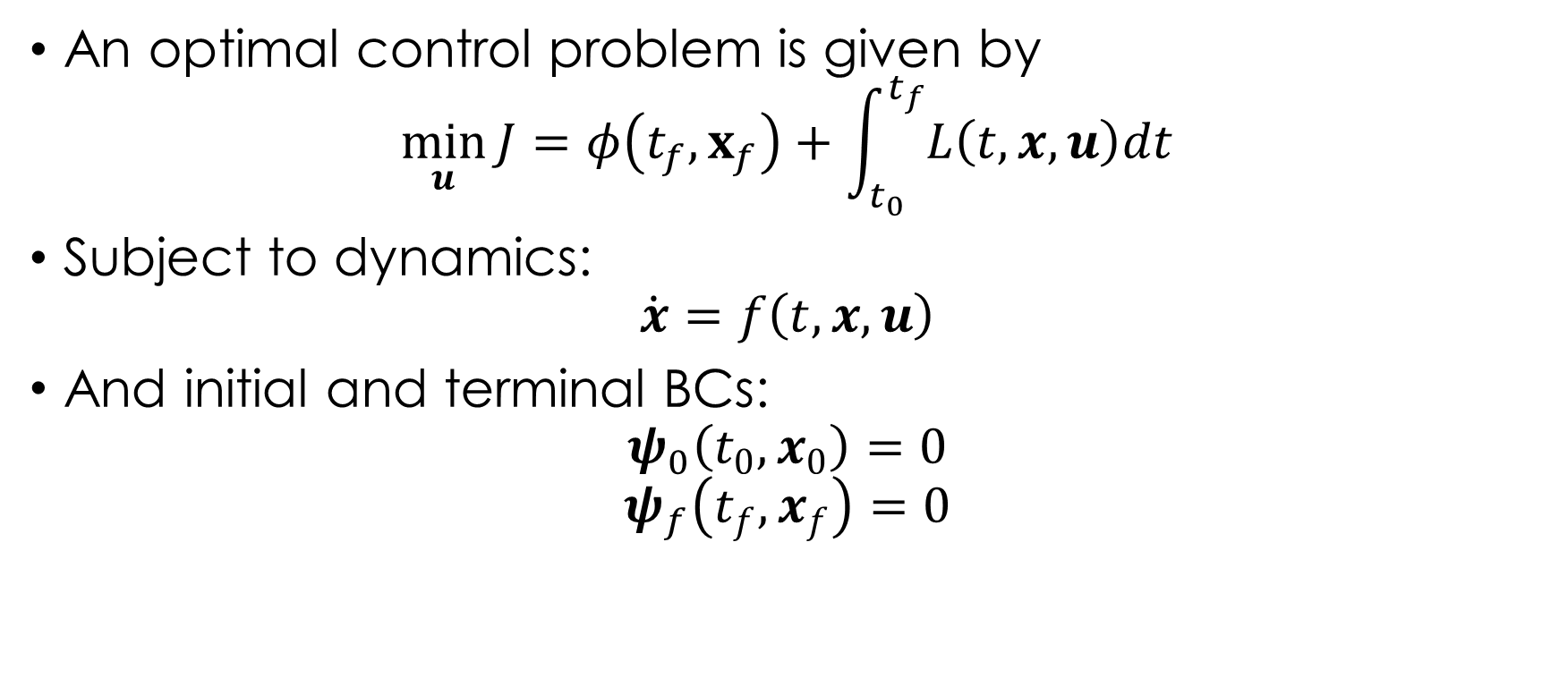
Optimal Control Problem
An optimal control problem is given by
$$\min_{u}{J}=φ\left(t_{f},x_{f}\right)+\int_{t_{0}}^{t_{f}}{L\left(t,x,u\right)dt}$$
Subject to dynamics:
$$\dot{x}=f\left(t,x,u\right)$$
And initial and terminal BCs:
$$ψ_{0}\left(t_{0},x_{0}\right)=0$$
$$ψ_{f}\left(t_{f},x_{f}\right)=0$$

Slide 10
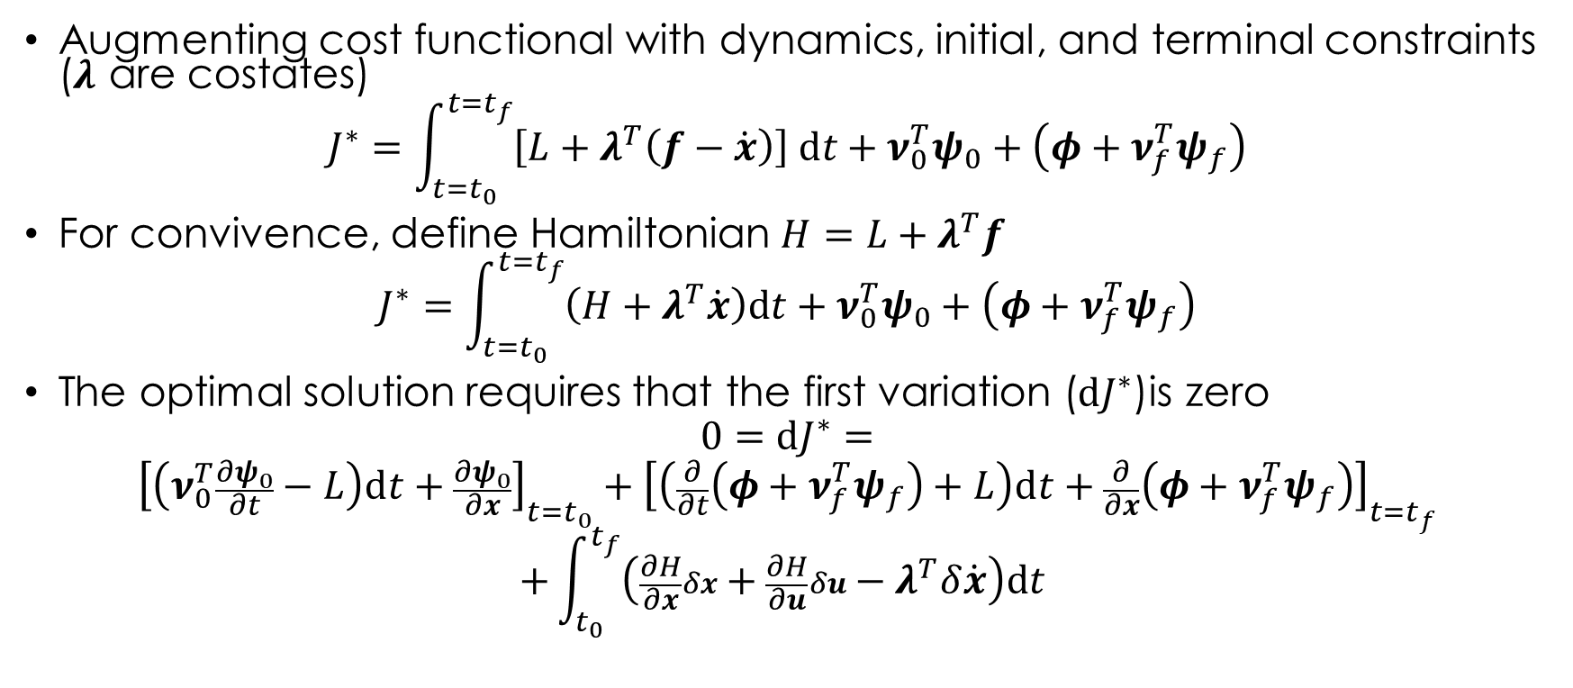
Indirect Optimization
Augmenting cost functional with dynamics, initial, and terminal constraints ($λ$ are costates)
$$J^{∗}=\int_{t=t_{0}}^{t=t_{f}}{\left[L+λ^{T}\left(f−\dot{x}\right)\right] dt}+ν_{0}^{T}ψ_{0}+\left(φ+ν_{f}^{T}ψ_{f}\right)$$
For convivence, define Hamiltonian $H=L+λ^{T}f$
$$J^{∗}=\int_{t=t_{0}}^{t=t_{f}}{\left(H+λ^{T}\dot{x}\right)dt}+ν_{0}^{T}ψ_{0}+\left(φ+ν_{f}^{T}ψ_{f}\right)$$
The optimal solution requires that the first variation ($dJ^{∗}$)is zero
$$0=dJ^{∗}=$$
$${\left[\left(ν_{0}^{T}\frac{∂ψ_{0}}{∂t}−L\right)dt+\frac{∂ψ_{0}}{∂x}\right]}_{t=t_{0}}+{\left[\left(\frac{∂}{∂t}\left(φ+ν_{f}^{T}ψ_{f}\right)+L\right)dt+\frac{∂}{∂x}\left(φ+ν_{f}^{T}ψ_{f}\right)\right]}_{t=t_{f}}$$
$$+\int_{t_{0}}^{t_{f}}{\left(\frac{∂H}{∂x}δx+\frac{∂H}{∂u}δu−λ^{T}δ\dot{x}\right)dt }$$

Slide 11
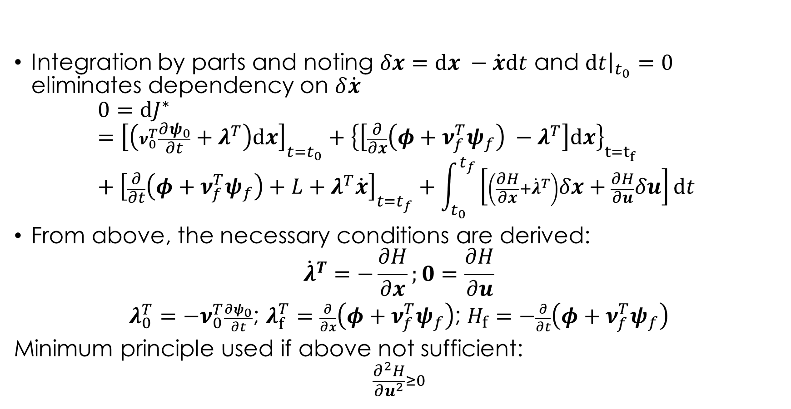
Indirect Optimization
Integration by parts and noting $δx=dx −\dot{x}dt$ and ${\left.dt\right|}_{t_{0}}=0$ eliminates dependency on $δ\dot{x}$
$$0=dJ^{∗}={\left[\left(ν_{0}^{T}\frac{∂ψ_{0}}{∂t}+λ^{T}\right)dx\right]}_{t=t_{0}}+{\left\{\left[\frac{∂}{∂x}\left(φ+ν_{f}^{T}ψ_{f}\right) −λ^{T}\right]dx\right\}}_{t=t_{f}}+{\left[\frac{∂}{∂t}\left(φ+ν_{f}^{T}ψ_{f}\right)+L+λ^{T}\dot{x}\right]}_{t=t_{f}}+\int_{t_{0}}^{t_{f}}{\left[\left(\frac{∂H}{∂x}+{\dot{λ}}^{T}\right)δx+\frac{∂H}{∂u}δu\right]dt }$$
From above, the necessary conditions are derived:
$${\dot{λ}}^{T}=−\frac{∂H}{∂x};0=\frac{∂H}{∂u}$$
$λ_{0}^{T}=−ν_{0}^{T}\frac{∂ψ_{0}}{∂t}$; $λ_{f}^{T}=\frac{∂}{∂x}\left(φ+ν_{f}^{T}ψ_{f}\right)$; $H_{f}=−\frac{∂}{∂t}\left(φ+ν_{f}^{T}ψ_{f}\right)$
Minimum principle used if above not sufficient:
$$\frac{∂^{2}H}{∂u^{2}}≥0$$

Slide 12
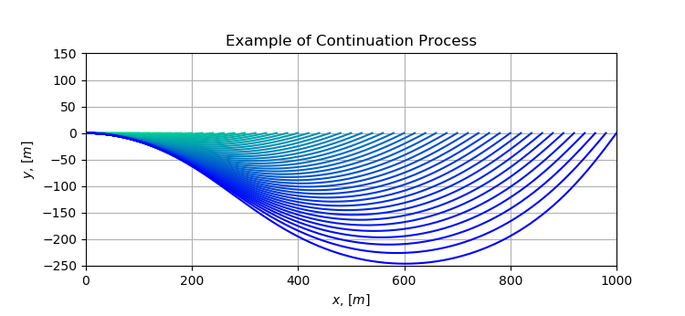
Continuation Method
Optimal control problems, particularly with indirect methods, are numerically sensitive and have small radius of convergence
Problems with difficult-to-solve BC values, constants, constraints, etc. need a sufficiently “close” guess
An easier to solver problem can be used as a guess for the harder one
The continuation sequentially solves more difficult problems using last solution as the guess for the current one

Slide 13





























Solving BVP
Collocation
Discretize trajectory into discrete nodes
Repose dynamics as constraints between nodes
Adjust state values at nodes until constraints satisfied
Shooting Methods
Propagates trajectory and STM using guess for initial conditions
Computes terminal BC error
Adjusts initial guess using linearized sensitivities from STM based on error
$$x$$
$$x_{3}^{1}$$
$$x_{0}^{1}$$
$$x_{2}^{1}$$
$$x_{3}^{∗}$$
$$x_{1}^{1}$$
$$x_{f}^{1}$$
$$x_{0}^{∗}$$
$$x_{0}^{∗}$$
$$x_{3}^{2}$$
$$x_{1}^{∗}$$
$$x_{2}^{2}$$
$$x_{0}^{∗}$$
$$x_{0}^{2}$$
$$x_{1}^{2}$$
$$x_{f}^{2}$$
$$t$$
$$t_{1}$$
$$t_{2}$$
$$t_{3}$$
$$t_{f}$$
$$x$$
$$x_{0}^{1}$$
$${Δx}_{f}^{1}$$
$$x_{0}^{∗}$$
$$x_{0}^{2}$$
$${Δx}_{f}^{2}$$
$$t$$
$$t_{f}$$

Slide 14
Examples

Slide 15
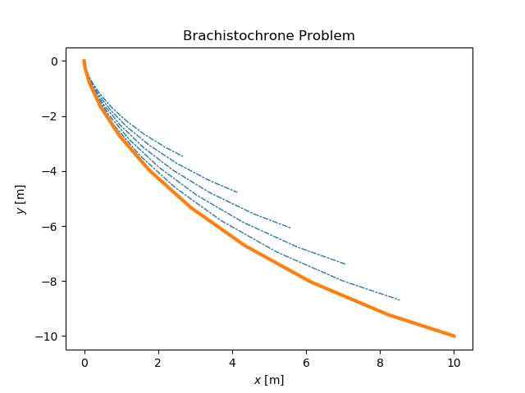
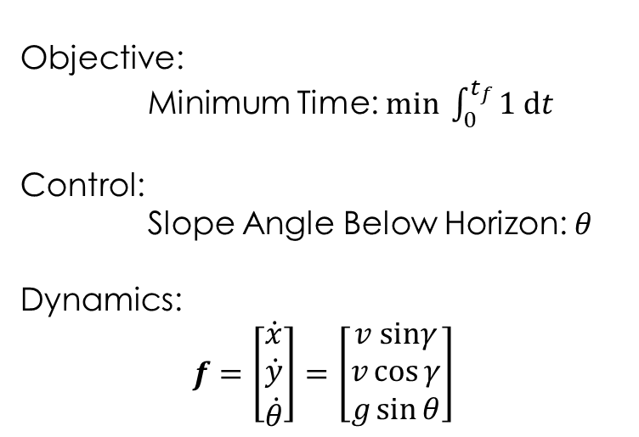
Brachistochrone Problem
Objective:
Minimum Time: $min \int_{0}^{t_{f}}{1 dt }$
Control:
Slope Angle Below Horizon: $θ$
Dynamics:
$$f=\left[\begin{aligned}\dot{x} \\ \dot{y} \\ \dot{θ}\end{aligned}\right]=\left[\begin{matrix}v sinγ \\ v\cos{γ} \\ g\sin{θ}\end{matrix}\right]$$

Slide 16
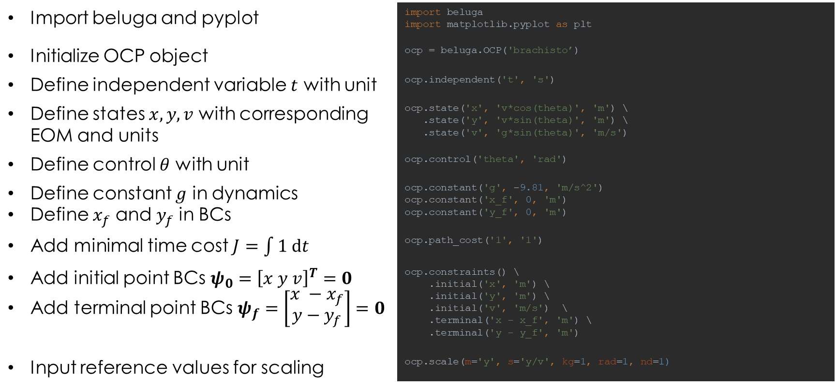
Brachistochrone Input
Import beluga and pyplot | import beluga import matplotlib.pyplot as plt
Initialize OCP object | ocp = beluga.OCP('brachisto’)
Define independent variable $t$ with unit | ocp.independent('t', 's')
Define states $x, y, v$ with corresponding EOM and units | ocp.state('x', 'v*cos(theta)', 'm') \ .state('y', 'v*sin(theta)', 'm') \ .state('v', 'g*sin(theta)', 'm/s')
Define control $θ$ with unit | ocp.control('theta', 'rad')
Define constant $g$ in dynamics Define $x_{f}$ and $y_{f}$ in BCs | ocp.constant('g', -9.81, 'm/s^2') ocp.constant('x_f', 0, 'm') ocp.constant('y_f', 0, 'm')
Add minimal time cost $J=\int{1 dt}$ | ocp.path_cost('1', '1')
Add initial point BCs $ψ_{0}={\left[x y v\right]}^{T}=0$ Add terminal point BCs $ψ_{f}=\left[\begin{aligned}x −x_{f} \\ y−y_{f}\end{aligned}\right]=0$ | ocp.constraints() \ .initial('x', 'm') \ .initial('y', 'm') \ .initial('v', 'm/s') \ .terminal('x - x_f', 'm') \ .terminal('y - y_f', 'm')
Input reference values for scaling | ocp.scale(m='y', s='y/v', kg=1, rad=1, nd=1)

Slide 17
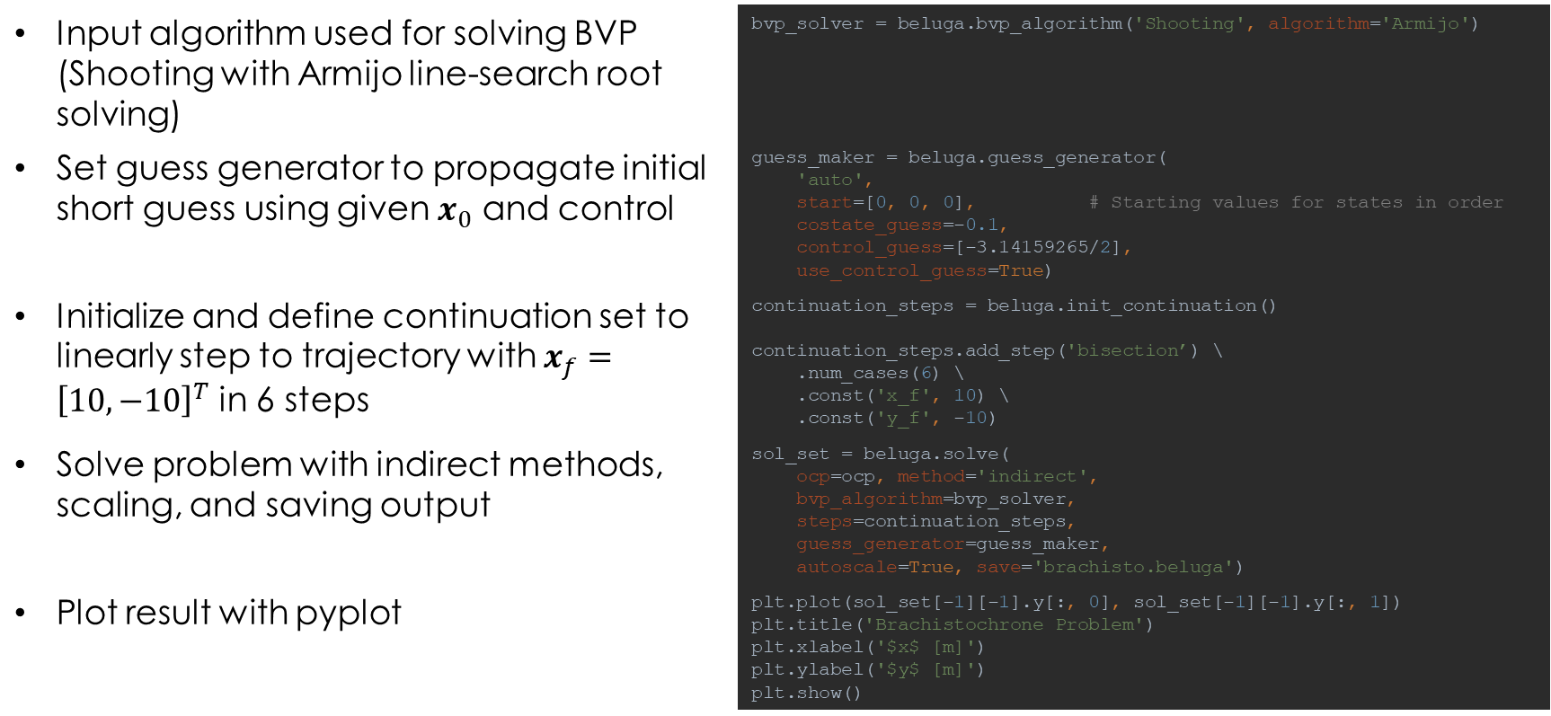
Brachistochrone Input
Input algorithm used for solving BVP (Shooting with Armijo line-search root solving) | bvp_solver = beluga.bvp_algorithm('Shooting', algorithm='Armijo')
Set guess generator to propagate initial short guess using given $x_{0}$ and control | guess_maker = beluga.guess_generator( 'auto', start=[0, 0, 0], # Starting values for states in order costate_guess=-0.1, control_guess=[-3.14159265/2], use_control_guess=True)
Initialize and define continuation set to linearly step to trajectory with $x_{f}={\left[10, −10\right]}^{T}$ in 6 steps | continuation_steps = beluga.init_continuation() continuation_steps.add_step('bisection’) \ .num_cases(6) \ .const('x_f', 10) \ .const('y_f', -10)
Solve problem with indirect methods, scaling, and saving output | sol_set = beluga.solve( ocp=ocp, method='indirect', bvp_algorithm=bvp_solver, steps=continuation_steps, guess_generator=guess_maker, autoscale=True, save='brachisto.beluga')
Plot result with pyplot | plt.plot(sol_set[-1][-1].y[:, 0], sol_set[-1][-1].y[:, 1]) plt.title('Brachistochrone Problem') plt.xlabel('$x$ [m]') plt.ylabel('$y$ [m]') plt.show()

Slide 18
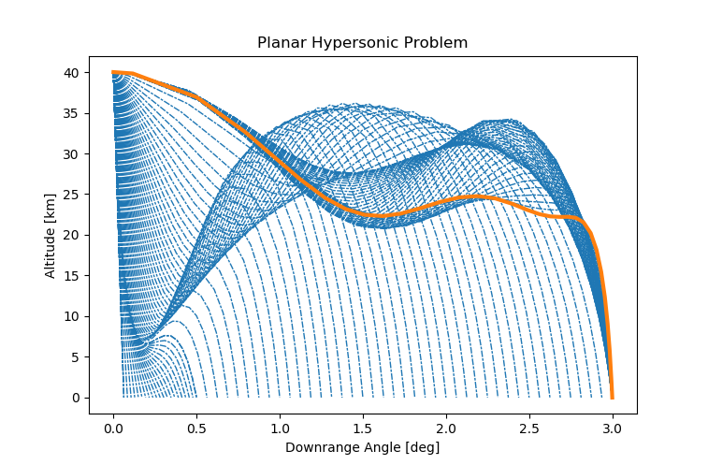
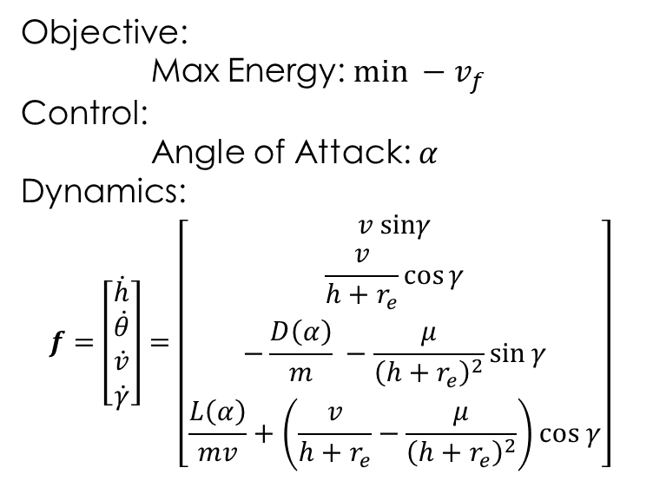
Planar Hypersonic Problem
Objective:
Max Energy: $min −v_{f}$
Control:
Angle of Attack: $α$
Dynamics:
$$f=\left[\begin{matrix}\dot{h} \\ \dot{θ} \\ \dot{v} \\ \dot{γ}\end{matrix}\right]=\left[\begin{matrix}v sinγ \\ \frac{v}{h+r_{e}}\cos{γ} \\ −\frac{D\left(α\right)}{m} −\frac{μ}{{\left(h+r_{e}\right)}^{2}}\sin{γ} \\ \frac{L\left(α\right)}{mv}+\left(\frac{v}{h+r_{e}}−\frac{μ}{{\left(h+r_{e}\right)}^{2}}\right)cos γ\end{matrix}\right]$$

Slide 19
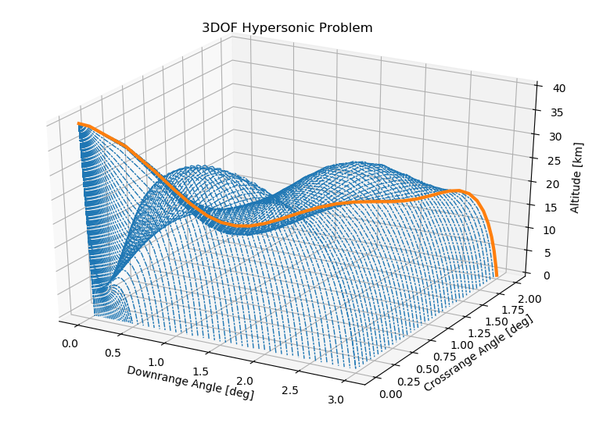
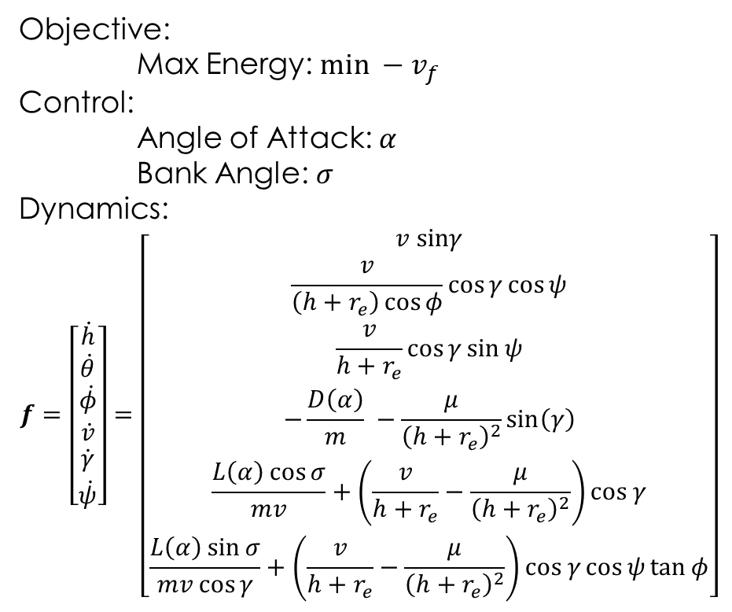
Hypersonic 3DOF Problem
Objective:
Max Energy: $min −v_{f}$
Control:
Angle of Attack: $α$
Bank Angle: $σ$
Dynamics:
$$f=\left[\begin{matrix}\dot{h} \\ \begin{aligned}\dot{θ} \\ \dot{φ}\end{aligned} \\ \dot{v} \\ \dot{\begin{aligned}γ \\ \dot{ψ}\end{aligned}}\end{matrix}\right]=\left[\begin{matrix}v sinγ \\ \begin{aligned}\frac{v}{\left(h+r_{e}\right)\cos{φ}}\cos{γ}\cos{ψ} \\ \frac{v}{h+r_{e}}\cos{γ}\sin{ψ}\end{aligned} \\ −\frac{D\left(α\right)}{m} −\frac{μ}{{\left(h+r_{e}\right)}^{2}}\sin\left(γ\right) \\ \begin{aligned}\frac{L\left(α\right)\cos{σ}}{mv}+\left(\frac{v}{h+r_{e}}−\frac{μ}{{\left(h+r_{e}\right)}^{2}}\right)cos γ \\ \frac{L\left(α\right)\sin{σ}}{mv\cos{γ}}+\left(\frac{v}{h+r_{e}}−\frac{μ}{{\left(h+r_{e}\right)}^{2}}\right)cos γ\cos{ψ}\tan{φ}\end{aligned}\end{matrix}\right]$$

Slide 20
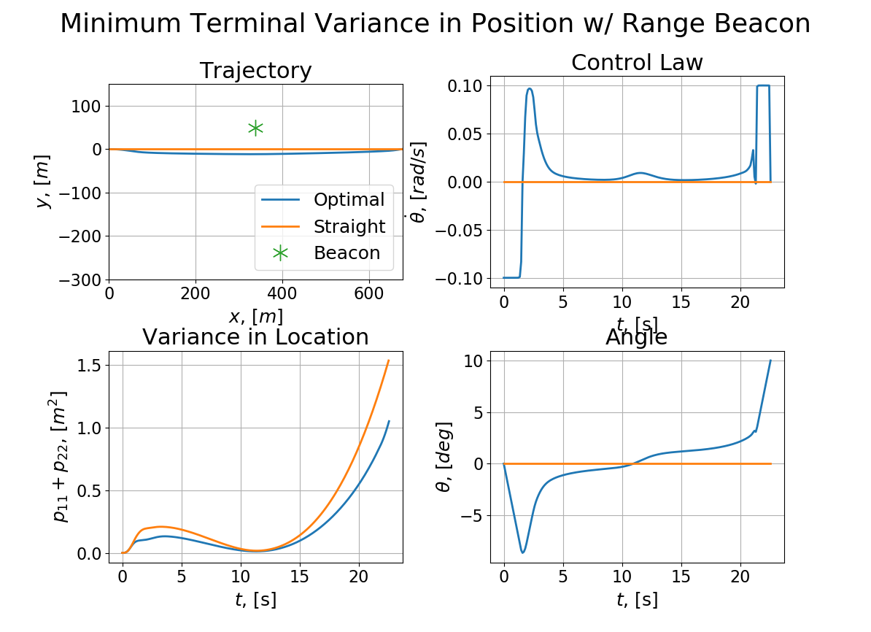






Navigation Based Path Planning
$$y$$
$$(x_{b},y_{b})$$
$$ρ$$
$$v$$
$$x$$
$$θ$$
Optimal Control Theory used to minimize state estimation errors of a vehicle

Slide 21







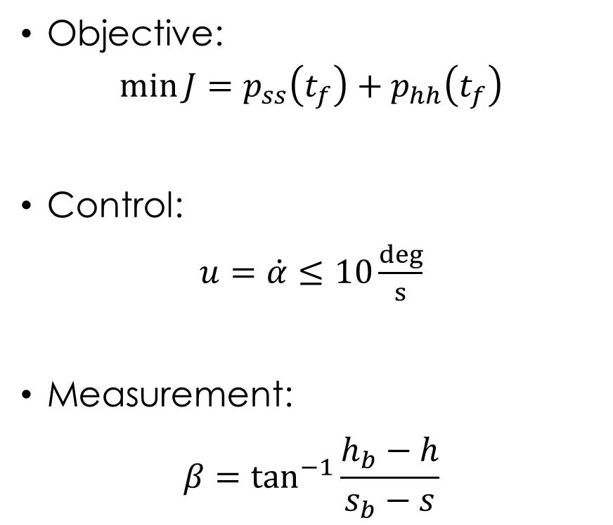
Aircraft Estimation Problem
$$h$$
Objective:
$$\min{J}=p_{ss}\left(t_{f}\right)+p_{hh}\left(t_{f}\right)$$
Control:
$u=\dot{α}≤10\frac{deg}{s}$
Measurement:
$$β=\tan^{−1}{\frac{h_{b}−h}{s_{b}−s}}$$
$$(s_{b},h_{b})$$
$$β$$
$$v$$
$$γ$$
$$s$$
$$(s_{target},0)$$

Slide 22
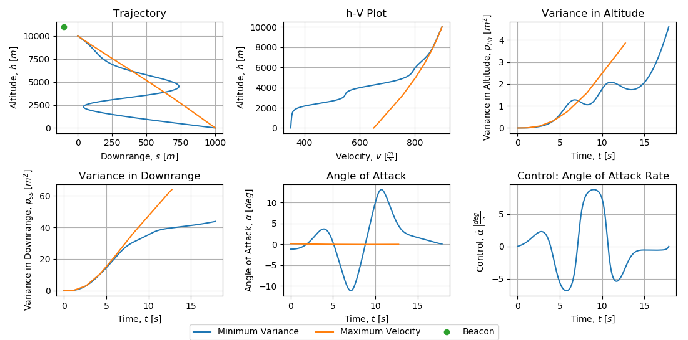
Aircraft Estimation Problem
Vehicle performs “S-curve” maneuvers similar to those in previous studies
Variance reduced from 67.7 m² to 48.3 m² (28.6% reduction)

Slide 23
Conclusion
Beluga provides an automated framework for solving optimal control problems using indirect methods
Available with MIT License from
https://github.com/Rapid-Design-of-Systems-Laboratory/beluga
PyPI with pip install beluga
Documentation: https://beluga.readthedocs.io/en/latest/
Anyone can use and contribute!

